Slide 1

MALLA REDDY COLLEGE OF ENGINEERING
(Approved by AICTE(New Delhi), Permanently Affiliated to JNTUH)
Recognised under Section 2(f) & 12(B) of the UGC Act 1956, An ISO 9001:2015 Certified Institution.
Problem Statement:Using AI to build an emergency response system that directs patients in remote areas to the nearest healthcare facility based on real-time conditions. Team Name: Code Crafters
Team Leader Name: G.Nikhil Sagar Institution Code: Q9 Institution name: Malla Reddy College of Engineering

Slide 2


Idea/Approach Details
Building an emergency response system to direct patients in remote areas to the nearest healthcare facility based on real-time conditions is an impactful use of AI:
Geolocation & Mapping:
Real-Time Location Tracking: The system should integrate GPS to track the patient’s exact location in real-time.
2. Healthcare Facility Database
Dynamic Data: Collect and maintain a real-time database of healthcare facilities, including hospitals, clinics, and mobile healthcare units.
3. AI-Powered Decision Making
AI can be used to assess the urgency of the patient’s condition based on information provided via the app (or through emergency services)
4. Real-Time Conditions Integration
Weather & Traffic Data: Integrate with real-time traffic and weather APIs (e.g., from Google Maps, Waze, or local transportation authorities) to predict and avoid potential delays in transportation due to adverse weather or road conditions (floods, snow, landslides, etc.).

Slide 3
Idea/Approach Details
5. Communication System
App Interface: A mobile app could serve as the main interface for patients. It should be user-friendly, with an option to input symptoms or request help via voice commands (especially useful if the patient is unable to type).
6. AI-Driven Resource Allocation
Prioritization: AI can help triage patients and prioritize care based on severity, guiding less critical cases to facilities with lower capacity while directing severe cases to specialized centers.
7. Security and Privacy
Encryption: Use secure communication channels (e.g., end-to-end encryption) to ensure that all patient data shared between the app, healthcare facility, and emergency responders is protected.
8. Challenges and Considerations
Data Quality & Availability
AI Model Accuracy
Technology Access
Real-Time Communication

Slide 4




Technology Stack
Components | Technologies/Tools
Mobile App(frontend) | Swift,kotlin
Backend | Python,Django,Java.MangoDB
AI&ML | TensorFLow,pyTorch,Sckit-learn
Real-Time Data Integration | Google Maps API, Open WeatherMap API
Cloud Infrastructure | AWS, Google Cloud, Microsoft Azure
Real-Time Communication | Firebase Cloud Messaging, Twilio, Socket.io, Pusher
Security & Privacy | SSL/TLS, AES, OAuth 2.0

Slide 5
Step-by-Step explanation of how the AI-driven emergency response system work
Step 1: Patient Identifies Emergency:
Input via Mobile App: The patient (or a bystander) opens the emergency response app on their phone. The app allows them to either:Manually input symptoms (e.g., chest pain, difficulty breathing, broken bones, etc.), or
Use voice commands to describe the situation
Step 2: Geolocation & Emergency Type Analysis:The app uses GPS to detect the patient's location, especially in remote areas. It also uses AI to classify emergency types (e.g., cardiac, trauma, stroke) based on the patient's description and health data, helping to quickly identify urgent cases.
Step 3: Data Integration (Roads, Weather, Traffic):The system integrates real-time data, including traffic, weather, and local emergency updates, to assess potential delays caused by roadblocks, storms, or disasters, ensuring optimal route planning for healthcare services.
Step 4: Healthcare Facility Assessment: Real-Time Facility Status: The system pulls real-time information from these facilities (either through direct integration with hospital systems or manually maintained data)

Slide 6
Step-by-Step explanation of how the AI-driven emergency response system work
Step 5: AI-Powered Routing & Recommendations:
Optimal Route Calculation: Using AI algorithms, the system calculates the best route from the patient’s current location to the selected healthcare facility, factoring in:Travel time: Estimated time to reach the facility, accounting for current traffic, weather, and road conditions.
Safety: Avoiding hazardous routes or areas affected by natural disasters.
Step 6: Communication and Updates:The app gives real-time voice and text updates with directions, continuously adjusting as the situation changes to guide the patient to the healthcare facility.
Step 7: Continuous Monitoring and Support:The app tracks the patient's location and ETA, alerts emergency services if needed, and shares vital health data with the hospital before arrival to prepare the medical team.
Step 9: Patient Arrival & Treatment
The patient arrives at the healthcare facility, and the staff is prepared for their condition based on the data sent ahead of time. They’re promptly triaged and treated.

Slide 7
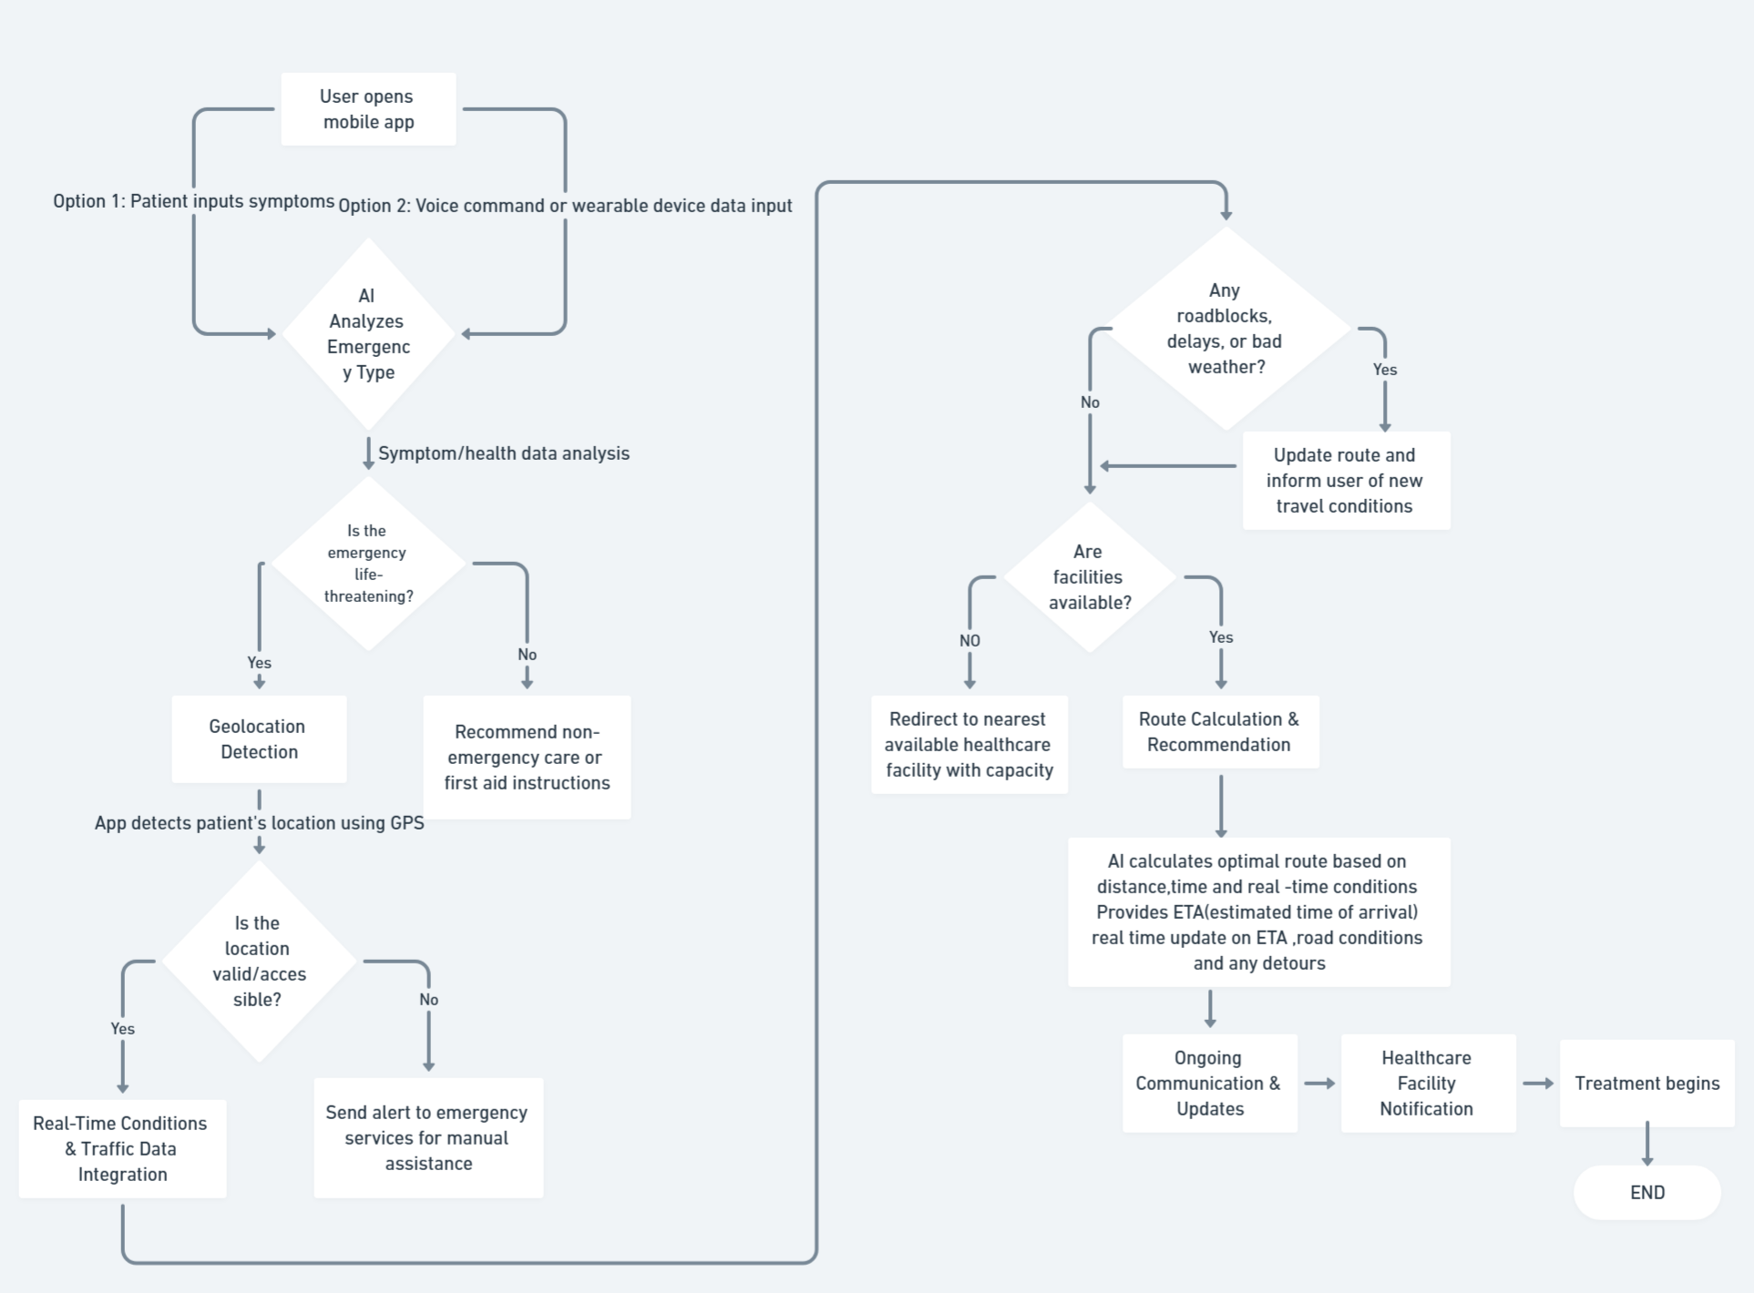
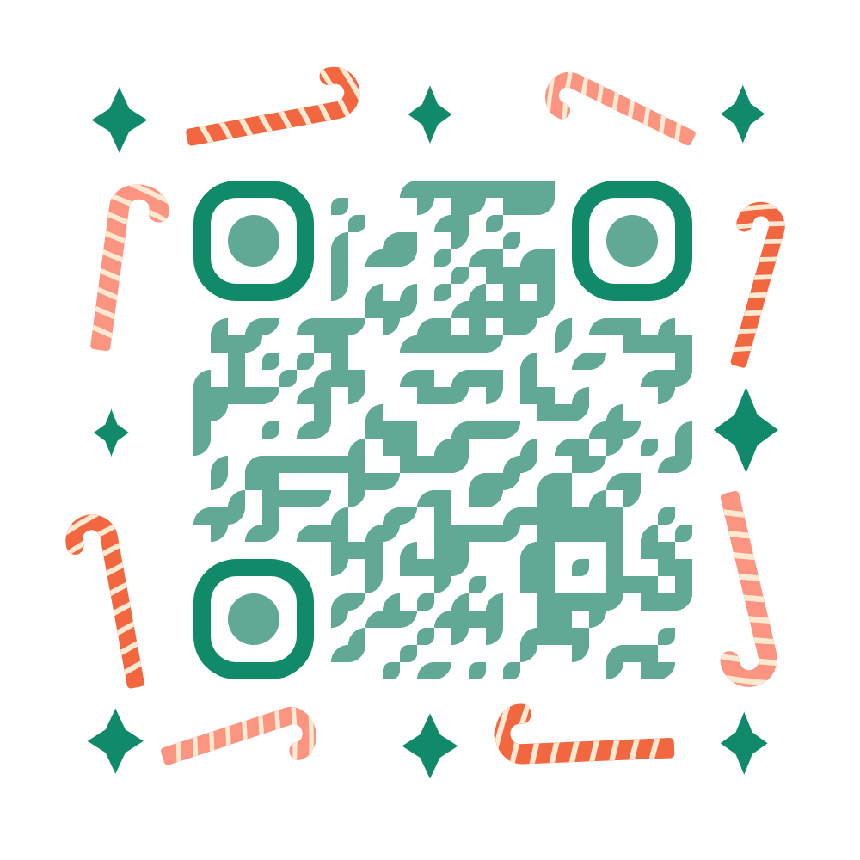
Flow Chat
Download Flow chat here:

Slide 8
Team Member Details
Team Leader Name: G. Nikhil Sagar
Branch : CSE-DS
Team Member 1 Name: B.Pranay
Branch :CSE-DS
Team Member 2 Name: Type : K.SaiKiran
Branch : CSE-DS
Thank You

